Slide 1
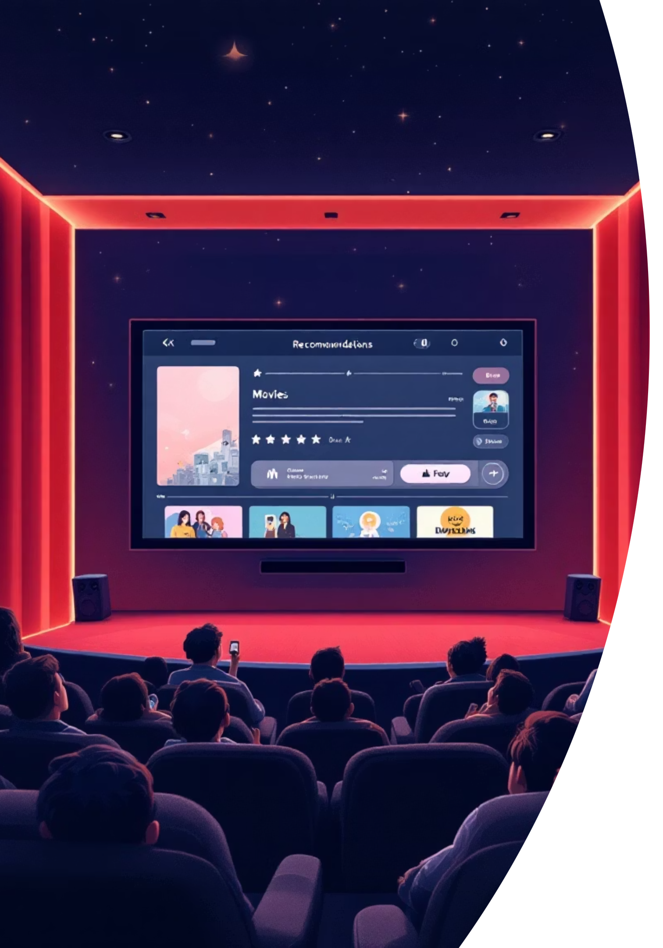

Movie Recommendation Workflow
AI-powered Recommendation System using OpenAI and Vector Stores
By: Aanchal Choudhary and Anshika Sinha

Slide 2
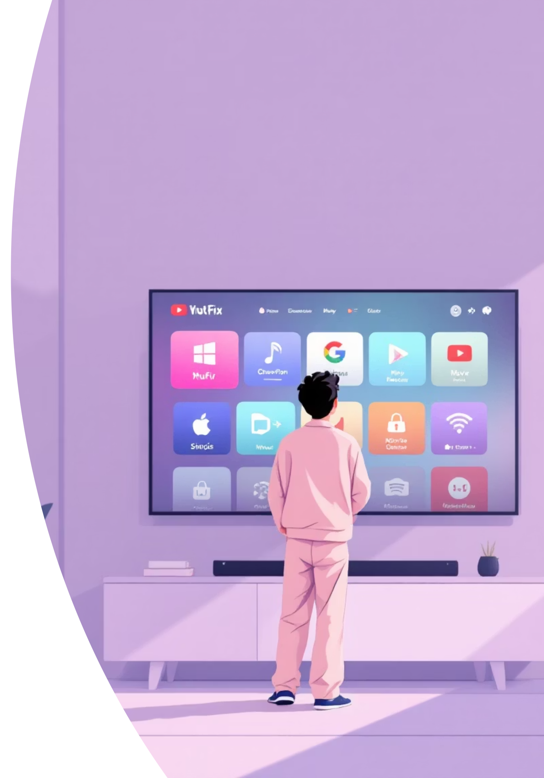
Problem Statement
Current OTT and movie platforms rely on limited user data, delivering generic suggestions that miss the mark. Traditional recommendation engines lack deep semantic understanding of what users truly want to watch.
Limited Data Analysis
Platforms analyze only surface-level viewing history without understanding context or preferences
Generic Suggestions
Users receive broad recommendations instead of personalized content matching their unique taste
Missing Semantic Understanding
Existing systems fail to comprehend the deeper meaning behind user preferences and movie attributes
Need for Intelligence
The industry requires a smarter, AI-driven pipeline that truly understands user intent

Slide 3

Objective
Our mission is to revolutionize movie recommendations by building an intelligent system that understands users at a semantic level.
01
Build Intelligent Workflow
Create a comprehensive movie recommendation system powered by advanced AI
02
Leverage OpenAI Embeddings
Utilize semantic similarity matching to understand deep connections between movies
03
Real-Time Chat Interface
Integrate recommendations seamlessly within an interactive AI conversation
04
Automate with n8n
Orchestrate the entire pipeline using n8n workflows and vector databases

Slide 4





Proposed Solution
We've designed a comprehensive pipeline that combines cutting-edge AI technology with proven automation tools to deliver truly personalized recommendations.
AI-Powered Pipeline
Integrate OpenAI embeddings, n8n automation, and Qdrant vector store for intelligent processing
Semantic Embeddings
Transform movie data into high-dimensional embeddings enabling efficient semantic search
Interactive Experience
Deliver personalized suggestions through an intuitive, conversational chat interface
Scalable Architecture
Build a flexible system easily adaptable to music, products, or any content domain

Slide 5
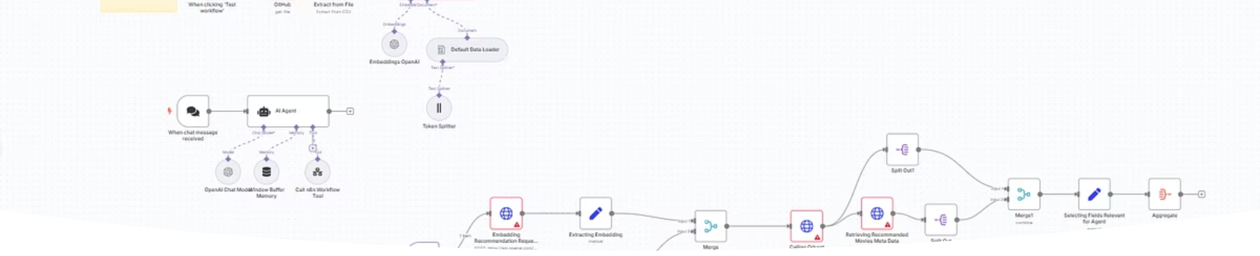
N8N Workflow Architecture
Our automation workflow orchestrates the entire recommendation pipeline, from data ingestion to real-time user interaction. Each node represents a critical step in transforming user queries into personalized movie suggestions.
Data Processing
Embedding Generation
Query Handling
Movie metadata is ingested and transformed into structured formats
OpenAI creates semantic embeddings stored in Qdrant
User queries trigger similarity searches returning top matches

Slide 6
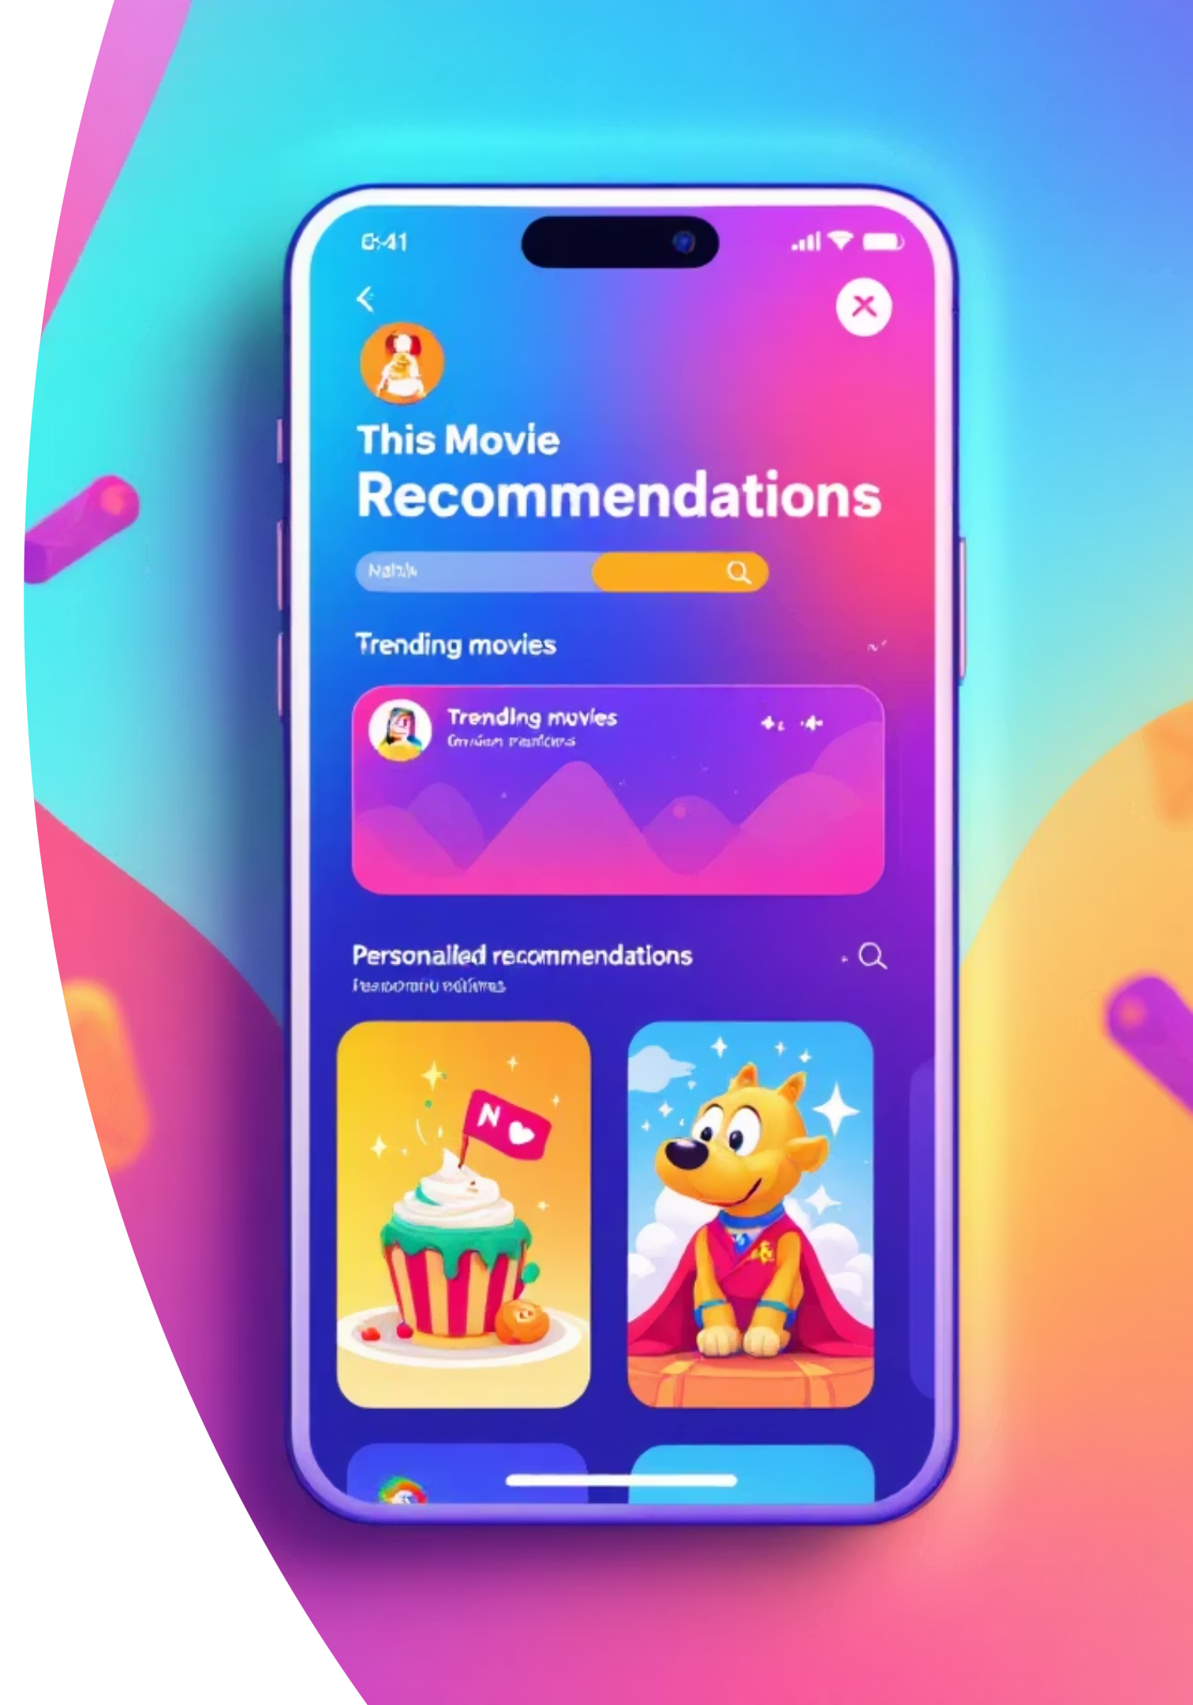
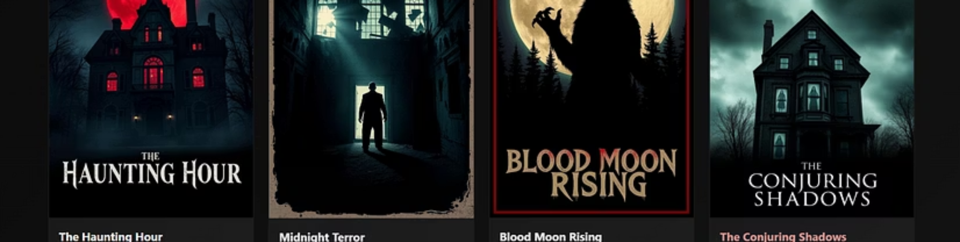
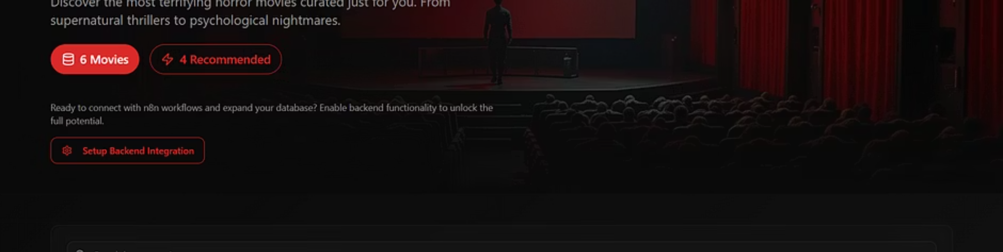
User Interface Experience
The chat interface provides an intuitive, conversational way for users to discover movies. Our AI agent understands natural language queries and responds with contextually relevant recommendations.
Users simply describe what they want to watch, and the AI agent delivers personalized recommendations with ratings, genres, and summaries—all in real-time.

Slide 7

Key Features
End-to-End Workflow
1
Complete movie recommendation pipeline from data ingestion to user delivery, fully automated
2
OpenAI + Qdrant Integration
Seamless connection between advanced embeddings and high-performance vector storage
Real-Time AI Agent
3
Interactive chat interface powered by intelligent conversation handling and context awareness
4
Personalized Results
Movie recommendations with detailed ratings, genres, and summaries tailored to each user

Slide 8

Conclusion
We've successfully built a fully automated, AI-powered movie recommendation system that sets a new standard for personalization and semantic understanding.
Full Automation
Seamless Integration
End-to-end AI-based recommender requiring no manual intervention
OpenAI, n8n, and vector databases working in perfect harmony
True Personalization
Future-Ready
Semantic-level recommendations that understand user intent
Adaptable architecture for music, products, and beyond

Slide 9

References & Acknowledgments
Technical Resources
Inspiration & Support
OpenAI API Documentation - Foundation for our embedding technology
Real-World Systems - Inspired by industry-leading recommendation platforms
n8n Workflow Automation - Orchestration platform powering our pipeline
Mentors & Guides - Invaluable expertise and feedback throughout development
Qdrant Vector Database - High-performance semantic search engine
Event Organizers - For providing the opportunity to showcase this innovation

Slide 10


Thank You
Questions & Discussion
We're excited to share more about our AI-powered movie recommendation system and explore how this approach can transform content discovery.
Contact us for collaboration opportunities or technical deep-dives into our implementation.

